Slide 1
iOS Audio Frameworks

Slide 2
Frameworks
Media Player
  + Access to iTunes library
  + Play tracks and playlists
  + Stream over AirPlay
  - No control over playback behavior
OpenAL
  + Industry standard for delivering positional audio
  + Frequently used by game developers
Core Audio
  + Sophisticated interfaces for recording and playback
  + Fine-grained control over audio (e.g., custom DSP processing)
  - Complex to implement
AV Foundation
  + Simple interface for recording, playback, and mixing

Slide 3
AV Foundation
Audio Session
  Play nicely with others: react to audio events from the System or other Apps
  Declare App’s audio capabilities/needs
  Configure sample rate, number of channels, I/O buffer duration, and other audio settings
  Activate/deactivate audio session
AV Audio Player
  File or buffer playback
    Cannot play streamed or networked audio
  Simple transport: stop, pause, play, seek, loop
  Simple channel: pan, volume, metering (rms and peak)
  Play multiple channels with precise synchronization
    But poor latency
  Conform to AVAudioPlayerDelegate @protocol

Slide 4
AV Foundation (cont’d)
AV Audio Engine
  Read/write audio files and buffers
  Record and playback audio
  Create and connect processing blocks (e.g., EQ)
  Capture audio anywhere along processing chain (analysis only … unless we hack it)
  3D audio support
  Multi-channel mixing capabilities

Slide 5
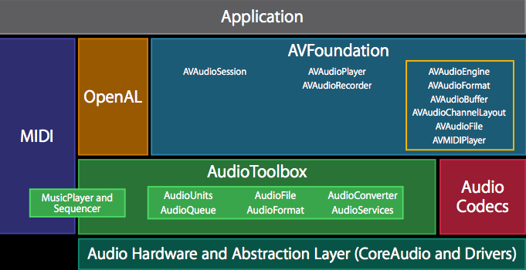

Slide 6
AV Audio Player
Import AVFoundation framework
  #import <AVFoundation/AVFoundation.h>
Create a property
  @property (nonatomic, strong) AVAudioPlayer* player;
Get reference to an audio file
  Save in Resource bundle
  NSURL* url = [[NSBundle mainBundle] URLForResource:@“ynq” withExtension:@“mp3”];
Alloc player with file
  self.player = [[AVAudioPlayer alloc] initWithContentsOfURL:url error:&err];
Interact with the player with simple commands
  [self.player play]; (or pause, or stop)

Slide 7
AV Audio Player
Let’s create simple channel strip and transport elements
Meters
  Inform player to provide levels for us to query
    self.player.meteringEnabled=YES;
  Setup a NSTimer to poll the player for channel levels
    Update the GUI on every timer firing with the new rms and/or peak levels
    Repeat for each channel
  Every time the timer fires, poll the player for levels
    [self.player updateMeters];
    [self.player averagePowerForChannel:bus];
    [self.player peakPowerForChannel:bus];
  Need to create a custom View to display level in dB-FS
0: Left
1: Right

Slide 8
AV Audio Player
Let’s create simple channel strip and transport elements
Need to create a custom View to display level in dB-FS
  Properties: MinValue, CurrentValue
  Methods: Init, Update, Clear, Draw
28 px
180/40=4.5 px/dB
180 px
-40 dB

Slide 9
AV Audio Player
Let’s create simple channel strip and transport elements
Need to create a custom View to display level in dB-FS
  Let dB-FS = -16.7 dB
  Draw a green rectangle of the appropriate size and context
28 px
Height = 16.7 (dB) x 4.5 (px/dB)
= 75.15 px
180 px
-40 dB

Slide 10
AV Audio Player
Let’s create simple channel strip and transport elements
Need to create a custom View to display level in dB-FS
28 px
Height = 12.0 (dB) x 4.5 (px/dB)
= 54 px
180 px
-40 dB

Slide 11
AV Audio Player
Let’s create simple channel strip and transport elements
Fast-Forward
  self.player.enableRate = YES;
  self.player.rate = x; // x = [0.5, 2.0]
Volume
  self.player.volume = x; // x = [0.0, 1.0]
Pan
  self.player.pan = x; // x = [-1.0, 1.0]
Seek slider
  Get self.player.currentTime / self.player.duration – now you have the percentage of the slider handle
    Set the location of the handle every time the timer fires

Slide 12
AV Audio Player
Let’s create simple channel strip and transport elements
Setting the seek slider
  If the User overrides the slider, stop the timer (but keep updating the labels, so we know where we are seeking to)
  When the User releases (Touch Up Inside), set self.player.currentTime (again, use percentage and duration to determine what this should be)
Conform to AV Audio Player Delegate
  audioPlayerDidFinishPlaying: successfully:
  audioPlayerDecodeErrorDidOccur: error:
  https://developer.apple.com/library/ios/documentation/AVFoundation/Reference/AVAudioPlayerClassReference/index.html#//apple_ref/occ/cl/AVAudioPlayer

